Slide 1

DIGITAL BOOKS
application

Slide 2
Table of Contents
Skill Detail
Business Requirements
Methodology

Slide 3
1.Skill Details
C#
.Net Core
SQL Server
Angular
Azure

Slide 4
Business Requirements
Required to build DigitalBooks application to be used by the wider community wherever they are. The system is built in the form of smart Digital Library application to search and buy books.
Below are the different roles need to be supported by this application
1.Author
2.Reader

Slide 5
AUTHOR
Below are author responsibilities
1.Author should have credentials to login/logout
2.Author should be able create account
3.Author can edit book
4.Author can Block/Unblock
a. If author block books, that particular book should not displayed in list of available books.
b. Buyer should get notification about unavailability of book.

Slide 6
READER:
Below are reader responsibilities
1.Reader can search books based on available filters.
2.Output results need to be displayed all the book properties like book logo, title, author, publisher, price, published date, content, category.
3.After search reader should be able to see all above properties and can select his desired book and able to buy book by giving name, email and book and reader can read only that particular book
4.Once the book is purchased successfully, paymentid needs to be generated for that particular reader.
5.After purchase reader should be able to download invoice and ask for refund with in 24 hours

Slide 7
Screens designed

Slide 8
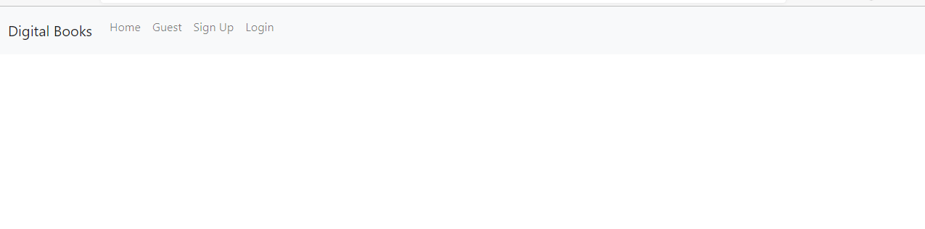
Dashboard Screen

Slide 9
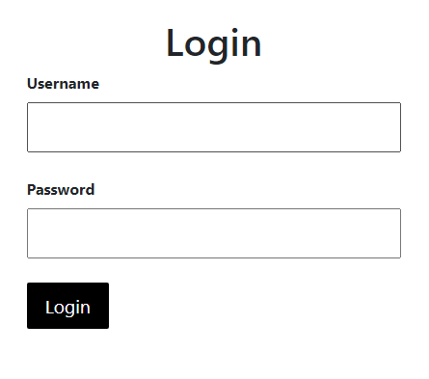
Login Screen

Slide 10
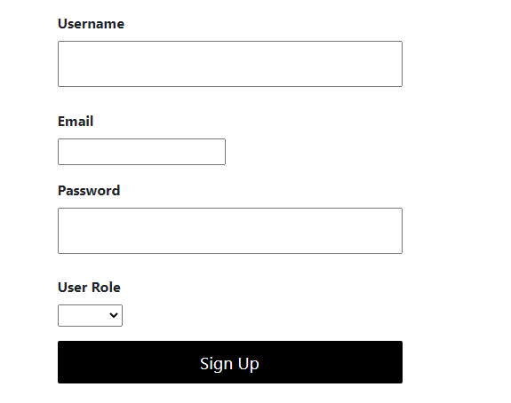
Signup Screen

Slide 11
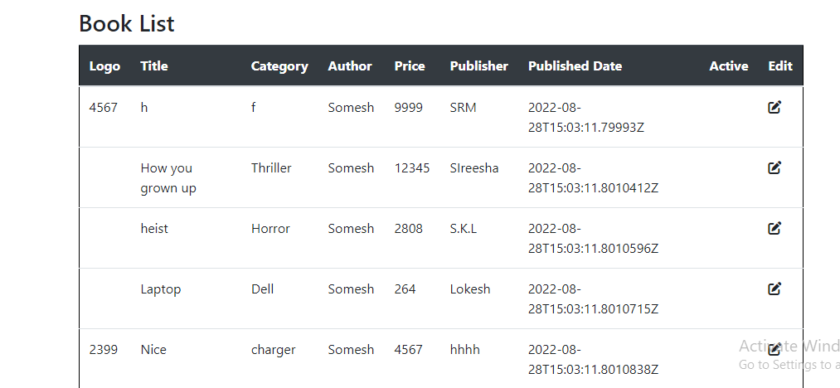
Author homepage Screen

Slide 12
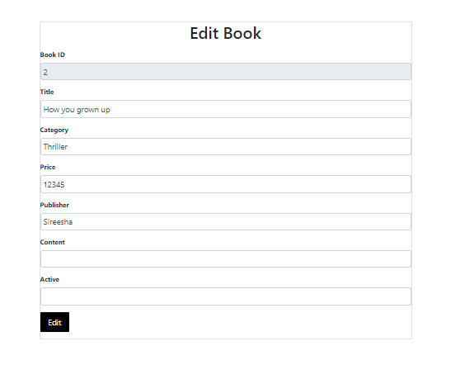
Author Editpage Screen

Slide 13
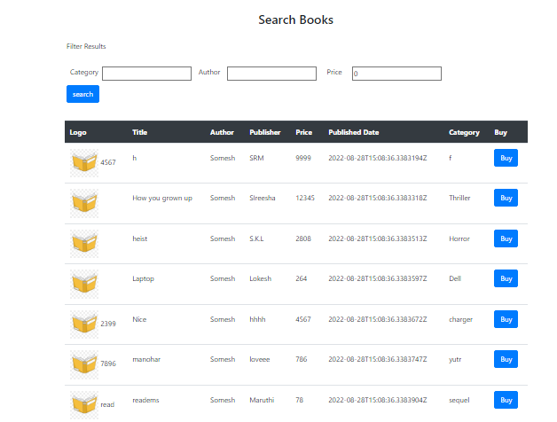
Reader homepage Screen

Slide 14
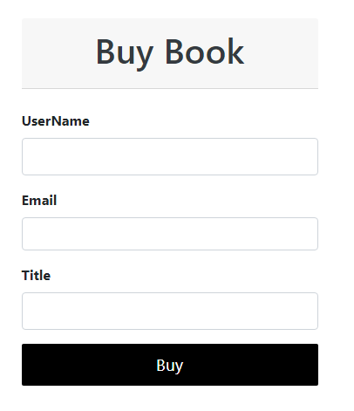
Purchase Screen

Slide 15
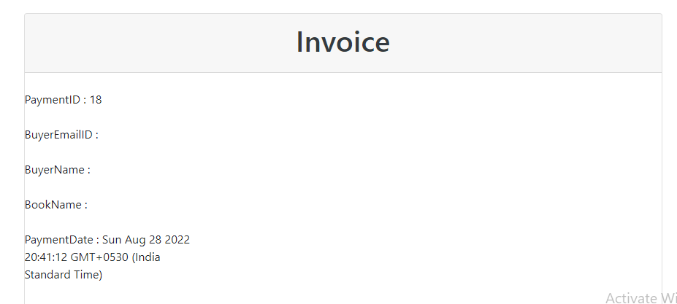
Invoice Screen

Slide 16
Methodology
Agile methodology is a way to manage a project by breaking it up to several phases. It involves continuous constant collaboration and continuous improvement at every stage. Once the work begins, teams cycle through a process of planning, executing, and evaluating. Continuous collaboration is vital with the team members.

Slide 17
ThankYou!

